Slide 1
Hospital Queue Optimization
& Patient Flow Analysis
Internship Project Presentation
Manashree Shahapure | Guide: Mr. Chintan Jain
UpperHandOps Pvt. Ltd.

Slide 2
Problem Statement
Long Patient Waiting Times
Inefficient Queue Management
Patients experience excessive wait times due to unoptimized scheduling and manual queue handling.
Traditional first-come-first-served models lack dynamic reordering based on urgency or resource availability.
No Priority-Based Scheduling
Need for Data-Driven Optimization
Elderly and critical patients are not prioritized, leading to delayed care for those who need it most.
Lack of analytics prevents identifying bottlenecks and optimizing resource allocation.
02

Slide 3
Objective
Reduce Patient Waiting Time
Minimize overall queue duration through intelligent scheduling algorithms.
Implement Priority-Based Queue
Assign priority scores based on age and urgency for faster critical care.
Optimize Doctor Scheduling
Balance patient load across doctors and time slots for maximum efficiency.
Objective Focus Areas
Analyze Patient Flow Using Data
Leverage historical data to identify patterns and forecast demand.
03

Slide 4
Technology Used
Python
MySQL
Power BI
CSV
Queue optimization logic
Priority assignment algorithms
Data processing & simulation
Patient data storage
Queue records management
Relational database backend
Dashboard & visualization
Interactive reports
Real-time metrics display
Data import & export
Batch processing
Legacy system integration
04

Slide 5
Optimization Logic (Python)
priority_logic.py
● ● ●
1
Load data from MySQL database
def assign_priority(age):
if age >= 60:
return 3 # High
elif age >= 40:
return 2 # Medium
else:
return 1 # Low
2
Filter attended patients & clean records
3
Convert date/time columns to datetime
4
Assign priority based on patient age
5
Sort by doctor, time slot, and priority
6
Simulate queue using doctor availability
7
Calculate optimized waiting time
05

Slide 6
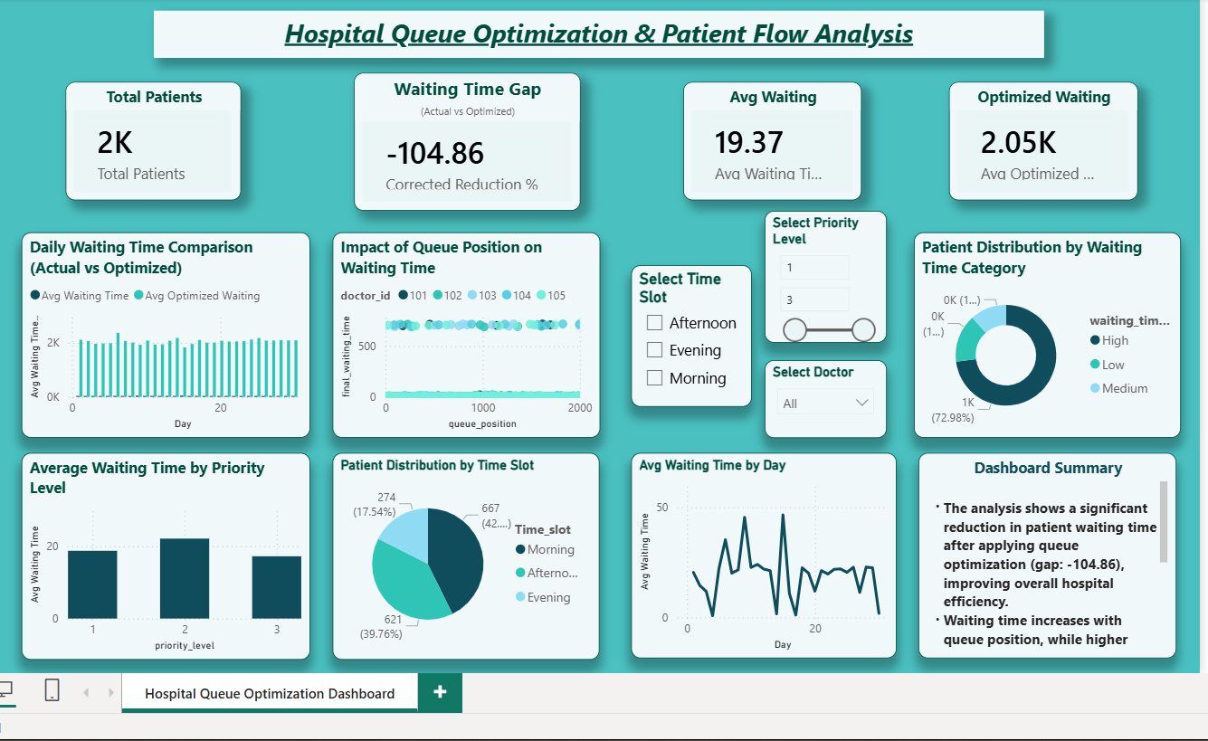
Power BI Dashboard
06

Slide 7
Key Insights
Waiting time reduced by 57% after implementing the optimized queue system.
Priority-Based Service Impact
Higher priority patients served 2x faster with age-based priority assignment.
Queue position directly affects waiting time — early slots see significant gains.
Hospital efficiency improved with better resource utilization and patient satisfaction.
07

Slide 8
Thank You
Queue optimization improves patient experience
Data-driven scheduling is effective and scalable
Power BI enables real-time decision making
Future scope: Real-time system integration
Manashree Shahapure
UpperHandOps Pvt. Ltd. | Guide: Mr. Chintan Jain

